Slide 1
The 8051 Microcontroller

Slide 2
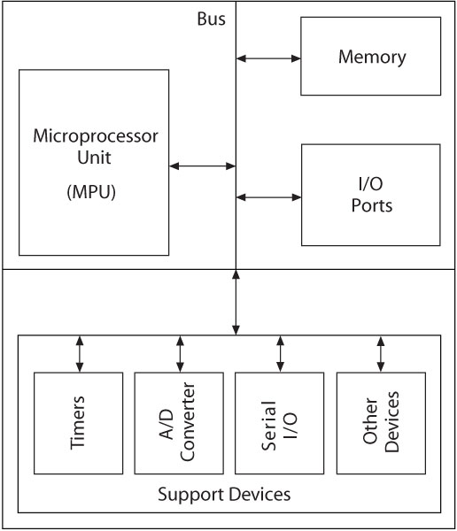
Block Diagram of µc
330_01
Notes:
ELEC 330

Slide 3
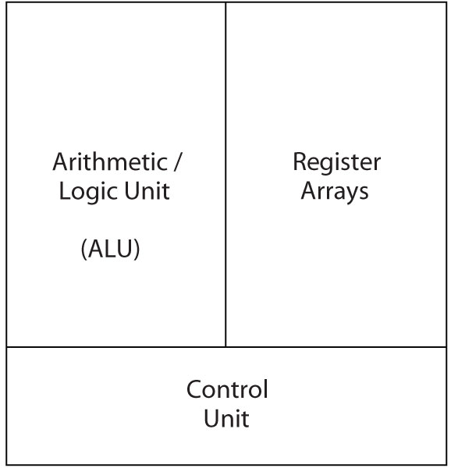
Microprocessor (MPU)
MPU (CPU)
  Read instructions
  Process binary data
330_01

Slide 4
Microprocessor vs. Microcontroller
Microcontroller
CPU, RAM, ROM, I/O and timer are all on a single chip
fixed amount of on-chip ROM, RAM, I/O ports
for applications in which cost, power and space are critical
single-purpose (control-oriented)
Low processing power
Low power consumption
Bit-level operations
Instruction sets focus on control and bit-level operations
Typically 8/16 bit
Typically single-cycle/two-stage pipeline
Microprocessor
CPU is stand-alone, RAM, ROM, I/O, timer are separate
designer can decide on the amount of ROM, RAM and I/O ports.
expensive
versatility
general-purpose
High processing power
High power consumption
Instruction sets focus on processing-intensive operations
Typically 32/64 – bit
Typically deep pipeline (5-20 stages)
ACOE343 - Real-Time Embedded Processor Systems - Frederick University
Notes:
versatility 多用途的: any number of applications for PC

Slide 5
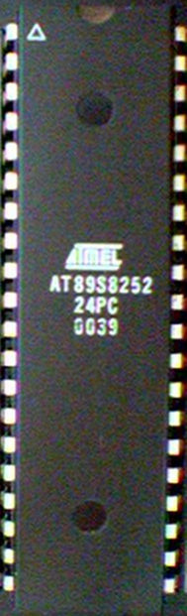
8051 Basic Component
4K bytes internal ROM
128 bytes internal RAM
Four 8-bit I/O ports (P0 - P3).
Two 16-bit timers/counters
One serial interface
CPU
RAM
ROM
A single chip
I/O Port
Serial COM Port
Microcontroller
Timer

Slide 6
Block Diagram
External Interrupts
Interrupt
Control
4k
ROM
128 bytes
RAM
Timer 1
Timer 2
CPU
OSC
Bus
Control
4 I/O Ports
Serial
P0 P2 P1 P3
TXD
RXD
Addr/Data

Slide 7
Other 8051 featurs
only 1 On chip oscillator (external crystal)
6 interrupt sources (2 external , 3 internal, Reset)
64K external code (program) memory(only read)PSEN
64K external data memory(can be read and write) by RD,WR
Code memory is selectable by EA (internal or external)
We may have External memory as data and code

Slide 8
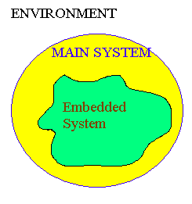
Embedded System
(8051 Application)
What is Embedded System?
  An embedded system is closely integrated with the main system
  It may not interact directly with the environment
  For example – A microcomputer in a car ignition control
  An embedded product uses a microprocessor or microcontroller to do one task only
  There is only one application software that is typically burned into ROM

Slide 9
Examples of Embedded Systems
Keyboard
Printer
video game player
MP3 music players
Embedded memories to keep configuration information
Mobile phone units
Domestic (home) appliances
Data switches
Automotive controls

Slide 10
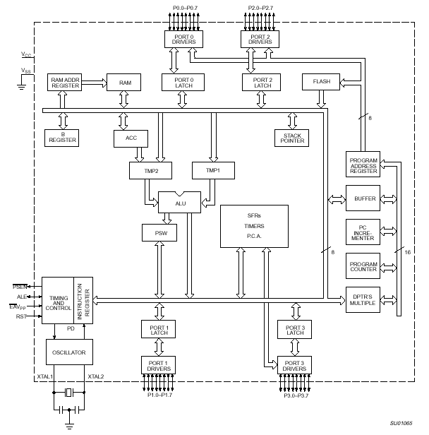
8051 Internal Block Diagram

Slide 11
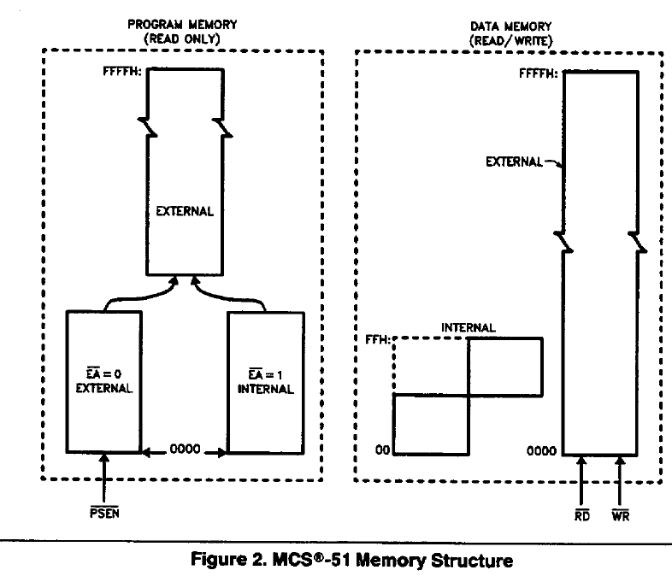
Memory Organization

Slide 12
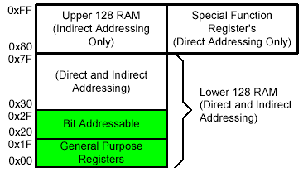
On-Chip Memory
Internal RAM

Slide 13
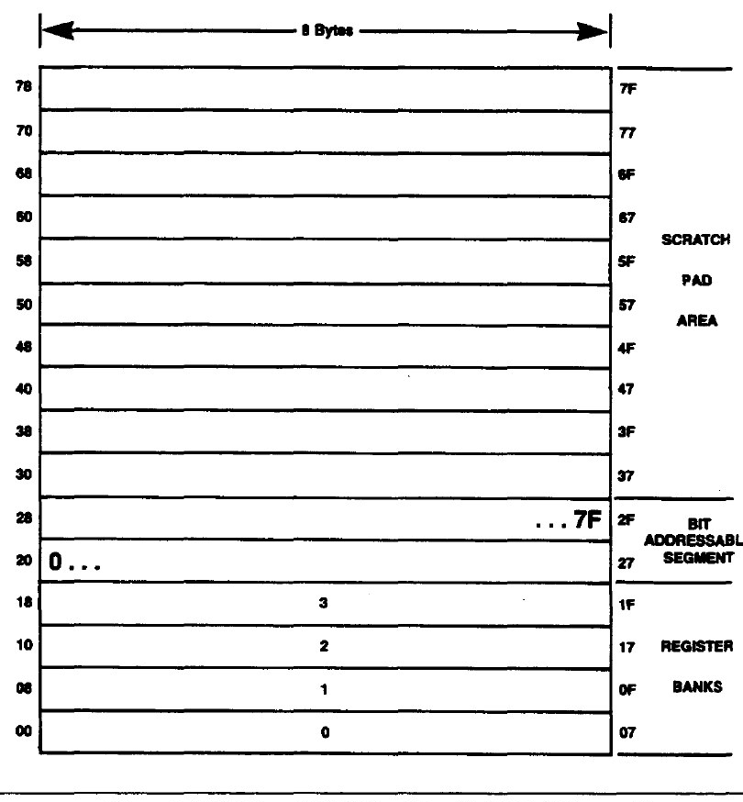
Internal data memory organization

Slide 14
Registers
1F
18
Bank 3
Four Register Banks
Each bank has R0-R7
Selectable by psw.2,3
17
10
Bank 2
0F
08
Bank 1
07
06
05
04
03
02
01
00
R7
R6
R5
R4
R3
R2
R1
R0
Bank 0

Slide 15
Register Banks
Active bank selected by PSW [RS1,RS0] bit
Permits fast “context switching” in interrupt service routines (ISR).

Slide 16
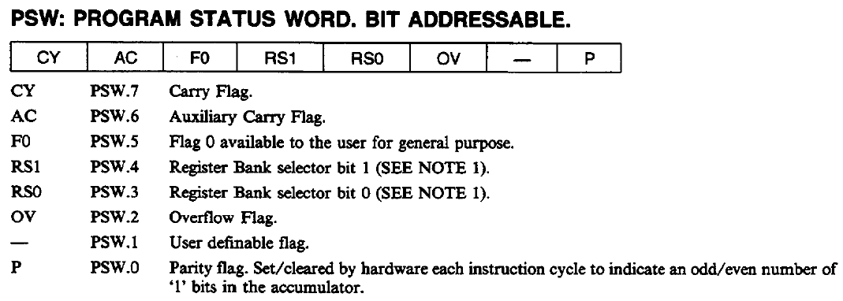
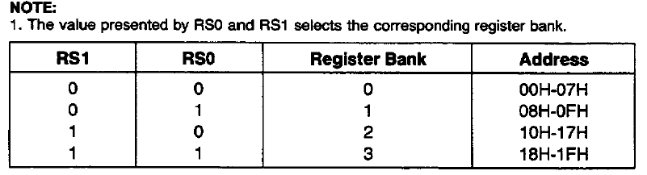

Slide 17
Bit Addressable Memory
2F
2E
2D
2C
2B
2A
29
28
7F |  |  |  |  |  |  | 78
 |  |  |  |  | 1A
 |  |  |  |  |  |  | 10
0F |  |  |  |  |  |  | 08
07 | 06 | 05 | 04 | 03 | 02 | 01 | 00
20h – 2Fh (16 locations X 8-bits = 128 bits)
Bit addressing:
mov C, 1Ah
or
mov C, 23h.2
27
26
25
24
23
22
21
20

Slide 18
Special Function Registers
DATA registers
CONTROL registers
  Timers
  Serial ports
  Interrupt system
  Analog to Digital converter
  Digital to Analog converter
  Etc.
Addresses 80h – FFh
Direct Addressing used to access SPRs

Slide 19
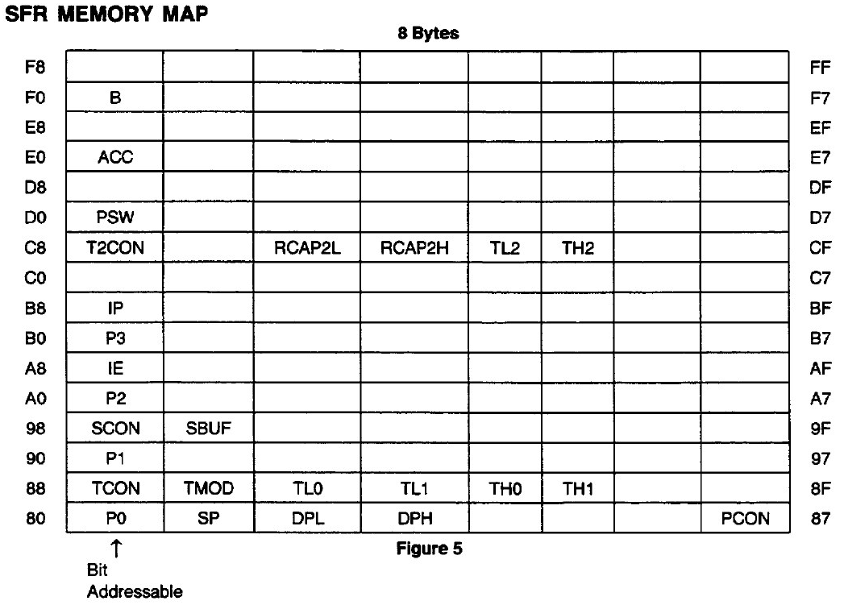
SFR Memory:

Slide 20
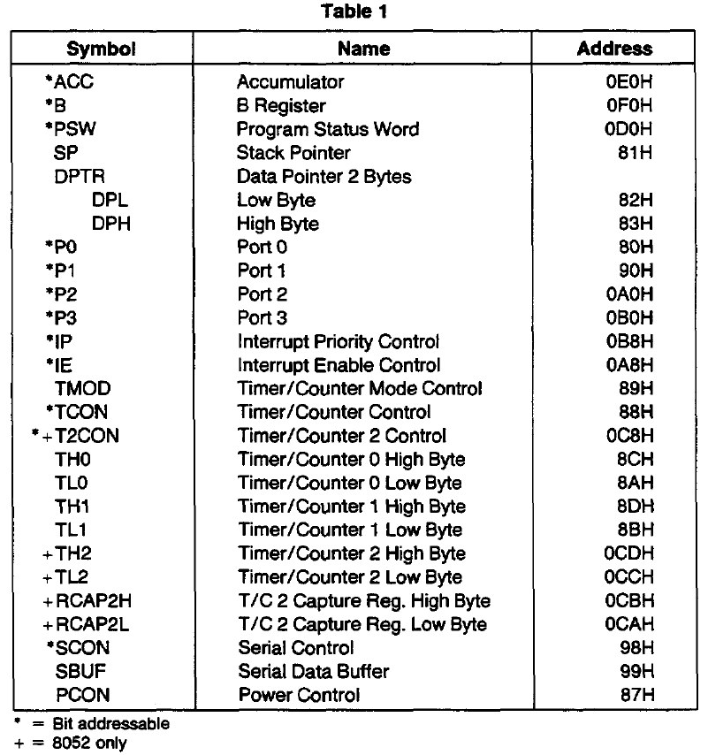
Addresses of Registers :

Slide 21
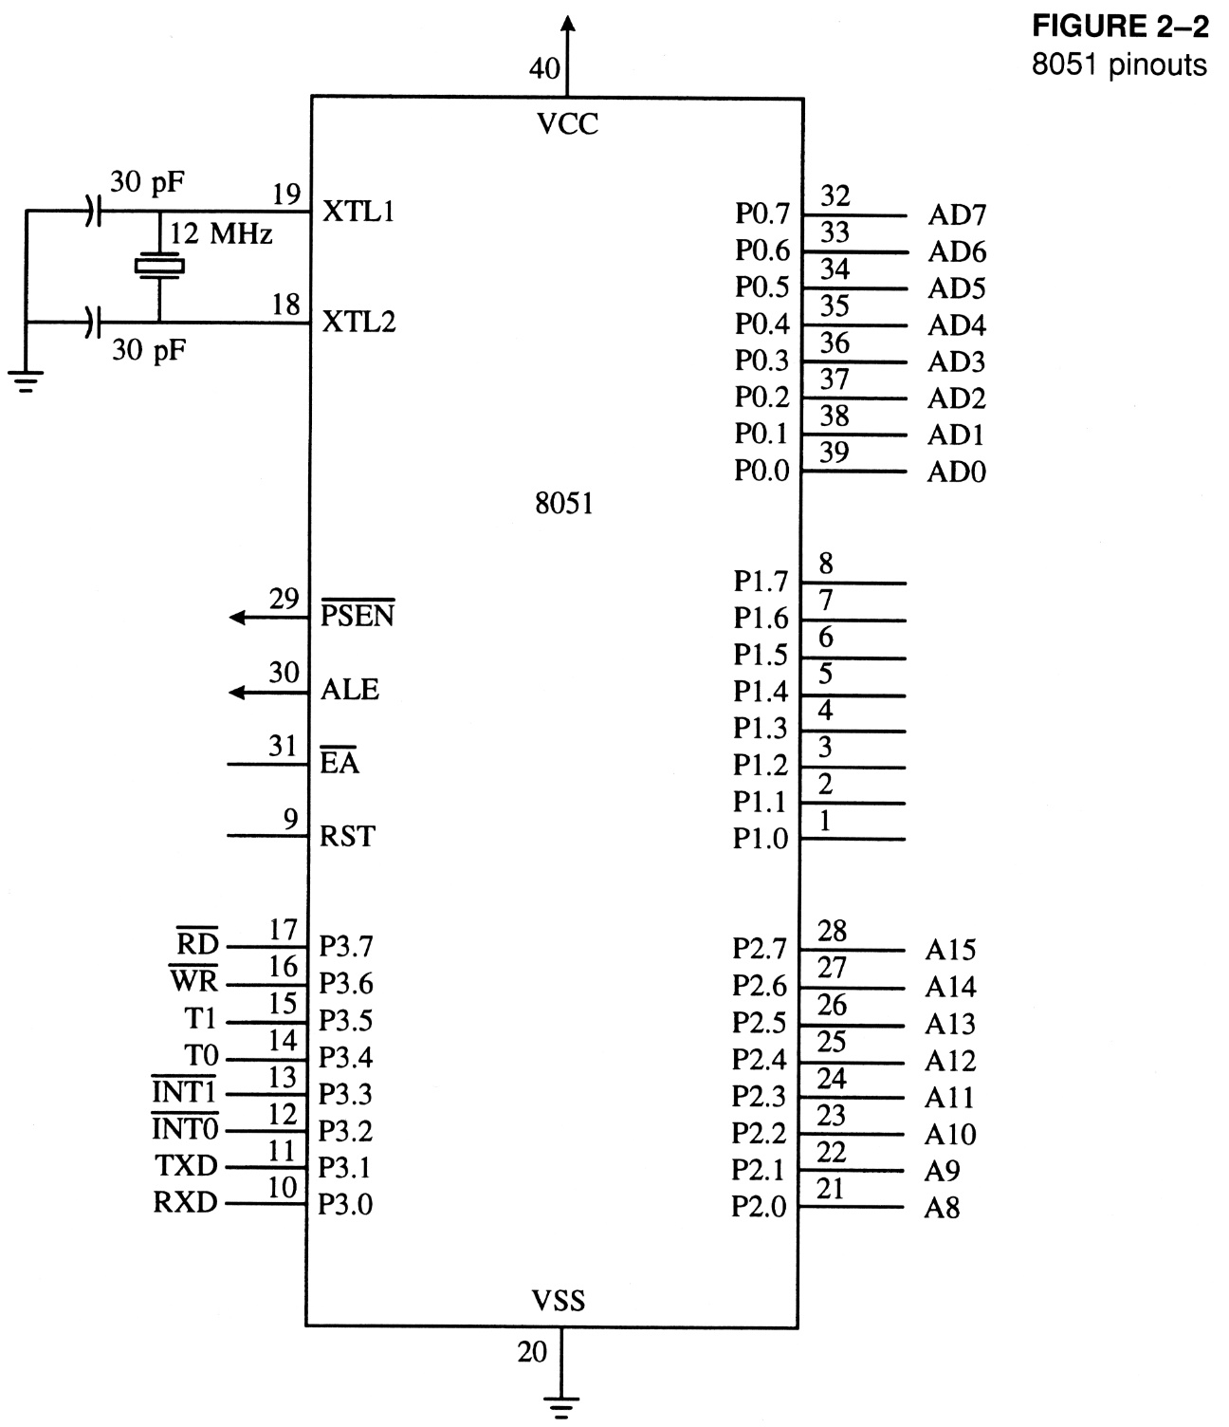
8051
Schematic Pin out

Slide 22
8051
Foot Print
P1.0
1
40
Vcc
P1.1
2
39
P0.0(AD0)
P1.2
3
38
P0.1(AD1)
P1.3
4
8051
(8031)
(8751)
(8951)
37
P0.2(AD2)
P1.4
5
36
P0.3(AD3)
P1.5
6
35
P0.4(AD4)
P1.6
7
34
P0.5(AD5)
P1.7
8
33
P0.6(AD6)
RST
9
32
P0.7(AD7)
(RXD)P3.0
10
31
EA/VPP
(TXD)P3.1
11
30
ALE/PROG
(INT0)P3.2
12
29
PSEN
(INT1)P3.3
13
28
P2.7(A15)
(T0)P3.4
14
27
P2.6(A14)
(T1)P3.5
15
26
P2.5(A13)
(WR)P3.6
16
25
P2.4(A12)
(RD)P3.7
17
24
P2.3(A11)
XTAL2
18
23
P2.2(A10)
XTAL1
19
22
P2.1(A9)
GND
20
21
P2.0(A8)

Slide 23
IMPORTANT PINS (IO Ports)
One of the most useful features of the 8051 is that it contains four I/O ports (P0 - P3)
Port 0 （pins 32-39）：P0（P0.0～P0.7）
  8-bit R/W - General Purpose I/O
  Or acts as a multiplexed low byte address and data bus for external memory design
Port 1 （pins 1-8） ：P1（P1.0～P1.7）
  Only 8-bit R/W - General Purpose I/O
Port 2 （pins 21-28）：P2（P2.0～P2.7）
  8-bit R/W - General Purpose I/O
  Or high byte of the address bus for external memory design
Port 3 （pins 10-17）：P3（P3.0～P3.7）
  General Purpose I/O
  if not using any of the internal peripherals (timers) or external interrupts.
Each port can be used as input or output (bi-direction)

Slide 24
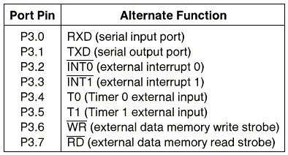
Port 3 Alternate Functions

Slide 25
IMPORTANT PINS
PSEN (out): Program Store Enable, the read signal for external program memory (active low).
ALE (out): Address Latch Enable, to latch address outputs at Port0 and Port2
EA (in): External Access Enable, active low to access external program memory locations 0 to 4K
RXD,TXD: UART pins for serial I/O on Port 3
XTAL1 & XTAL2: Crystal inputs for internal oscillator.

Slide 26
Pins of 8051
Vcc（pin 40）：
  Vcc provides supply voltage to the chip.
  The voltage source is +5V.
GND（pin 20）：ground
XTAL1 and XTAL2（pins 19,18）：
  These 2 pins provide external clock.
  Way 1：using a quartz crystal oscillator
  Way 2：using a TTL oscillator
  Example 4-1 shows the relationship between XTAL and the machine cycle.

Slide 27
XTAL Connection to 8051
Using a quartz crystal oscillator
We can observe the frequency on the XTAL2 pin.
C2
XTAL2
30pF
C1
XTAL1
30pF
GND

Slide 28
Machine cycle
Find the machine cycle for
(a) XTAL = 11.0592 MHz
(b) XTAL = 16 MHz.
Solution:
(a) 11.0592 MHz / 12 = 921.6 kHz;
machine cycle = 1 / 921.6 kHz = 1.085 μs
(b) 16 MHz / 12 = 1.333 MHz;
machine cycle = 1 / 1.333 MHz = 0.75 μs

Slide 29
Pins of 8051
RST（pin 9）：reset
  input pin and active high（normally low）.
    The high pulse must be high at least 2 machine cycles.
  power-on reset.
    Upon applying a high pulse to RST, the microcontroller will reset and all values in registers will be lost.
    Reset values of some 8051 registers
  power-on reset circuit

Slide 30
RESET Value of Some 8051 Registers:
Register
Reset Value
PC
0000
ACC
0000
B
0000
PSW
0000
SP
0007
DPTR
0000
RAM are all zero


Slide 31
Pins of 8051
/EA（pin 31）：external access
  There is no on-chip ROM in 8031 and 8032 .
  The /EA pin is connected to GND to indicate the code is stored externally.
  /PSEN ＆ ALE are used for external ROM.
  For 8051, /EA pin is connected to Vcc.
  “/” means active low.
/PSEN（pin 29）：program store enable
  This is an output pin and is connected to the OE pin of the ROM.
  See Chapter 14.

Slide 32
Pins of 8051
ALE（pin 30）：address latch enable
  It is an output pin and is active high.
  8051 port 0 provides both address and data.
  The ALE pin is used for de-multiplexing the address and data by connecting to the G pin of the 74LS373 latch.

Slide 33
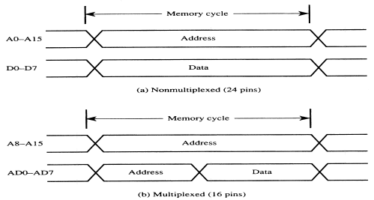
Address Multiplexing for External Memory
Figure 2-7
Multiplexing the address (low-byte) and data bus

Slide 34
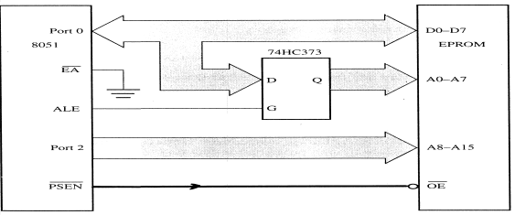
Address Multiplexing for External Memory
Figure 2-8
Accessing external code memory

Slide 35
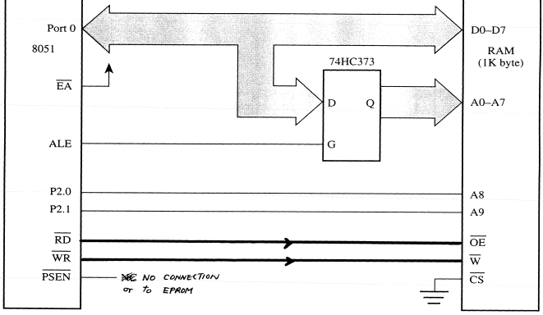
Accessing External
Data Memory
Figure 2-11
Interface to 1K RAM

Slide 36
Overlapping External Code and Data Spaces
Allows the RAM to be
  written as data memory, and
  read as data memory as well as code memory.
This allows a program to be
  downloaded from outside into the RAM as data, and
  executed from RAM as code.

Slide 38
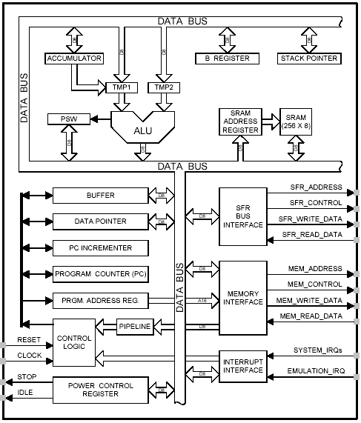
8051 CPU Registers
A (Accumulator)
B
PSW (Program Status Word)
SP (Stack Pointer)
PC (Program Counter)
DPTR (Data Pointer)
Used in assembler instructions

Slide 39
Registers
A
B
R0
DPTR
DPH
DPL
R1
R2
PC
PC
R3
R4
Some 8051 16-bit Register
R5
R6
R7
Some 8-bit Registers of the 8051

Slide 40
The 8051
Assembly Language

Slide 41
Overview
Data transfer instructions
Addressing modes
Data processing (arithmetic and logic)
Program flow instructions

Slide 42
Addressing Modes
Immediate Mode – specify data by its value
  mov A, #0 ;put 0 in the accumulator
  ;A = 00000000
  mov R4, #11h ;put 11hex in the R4 register
  ;R4 = 00010001
  mov B, #11 ;put 11 decimal in b register
  ;B = 00001011
  mov DPTR,#7521h ;put 7521 hex in DPTR
  ;DPTR = 0111010100100001

Slide 43
Addressing Modes
Register Addressing – either source or destination is one of CPU register
MOV R0,A
  MOV A,R7
  ADD A,R4
  ADD A,R7
  MOV DPTR,#25F5H
  MOV R5,DPL
  MOV R,DPH
Note that MOV R4,R7 is incorrect

Slide 44
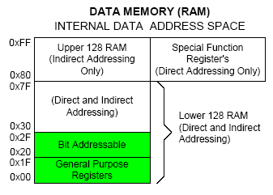
Addressing Modes
Direct Mode – specify data by its 8-bit address
Usually for 30h-7Fh of RAM
  Mov a, 70h ; copy contents of RAM at 70h to a
  Mov R0,40h ; copy contents of RAM at 70h to a
  Mov 56h,a ; put contents of a at 56h to a
  Mov 0D0h,a ; put contents of a into PSW

Slide 45
Addressing Modes
Register Indirect – the address of the source or destination is specified in registers
Uses registers R0 or R1 for 8-bit address:
  mov psw, #0 ; use register bank 0
  mov r0, #0x3C
  mov @r0, #3 ; memory at 3C gets #3
  ; M[3C] ← 3
Uses DPTR register for 16-bit addresses:
  mov dptr, #0x9000 ; dptr ← 9000h
  movx a, @dptr ; a ← M[9000]
  Note that 9000 is an address in external memory

Slide 46
Use Register Indirect to access upper RAM block (+8052)

Slide 47
Addressing Modes
Register Indexed Mode – source or destination address is the sum of the base address and the accumulator(Index)
Base address can be DPTR or PC
    mov dptr, #4000h
    mov a, #5
    movc a, @a + dptr ;a ← M[4005]

Slide 48
Data Transfer Instructions
MOV dest, source dest ← source
Stack instructions
  PUSH byte ;increment stack pointer, ;move byte on stack
  POP byte ;move from stack to byte, ;decrement stack pointer
Exchange instructions
  XCH a, byte ;exchange accumulator and byte
  XCHD a, byte ;exchange low nibbles of ;accumulator and byte

Slide 49
Stacks
pop
push
stack pointer
stack
Go do the stack exercise…..

Slide 50
Stack
Stack-oriented data transfer
  Only one operand (direct addressing)
  SP is other operand – register indirect - implied
Direct addressing mode must be used in Push and Pop
  mov sp, #0x40 ; Initialize SP
  push 0x55 ; SP ← SP+1, M[SP] ← M[55]
  ; M[41] ← M[55]
  pop b ; b ← M[55]
Note: can only specify RAM or SFRs (direct mode) to push or pop. Therefore, to push/pop the accumulator, must use acc, not a

Slide 51
Exchange Instructions
two way data transfer
  XCH a, 30h ; a ←→ M[30]
  XCH a, R0 ; a ←→ R0
  XCH a, @R0 ; a ←→ M[R0]
  XCHD a, R0 ; exchange “digit”
a[7..4] a[3..0]
R0[7..4] R0[3..0]
Only 4 bits exchanged

Slide 52
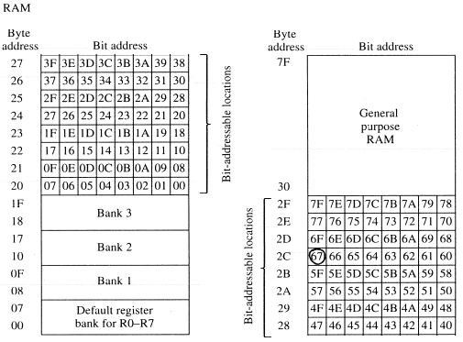
Bit-Oriented Data Transfer
transfers between individual bits.
Carry flag (C) (bit 7 in the PSW) is used as a single-bit accumulator
RAM bits in addresses 20-2F are bit addressable
mov C, P0.0
mov C, 67h
mov C, 2ch.7

Slide 53
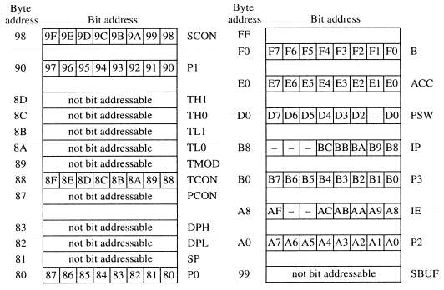
SFRs that are Bit Addressable
SFRs with addresses ending in 0 or 8 are bit-addressable.
  (80, 88, 90, 98, etc)
Notice that all 4 parallel I/O ports are bit addressable.

Slide 54
Data Processing Instructions
Arithmetic Instructions
Logic Instructions

Slide 55
Arithmetic Instructions
Add
Subtract
Increment
Decrement
Multiply
Divide
Decimal adjust

Slide 56
Arithmetic Instructions
Mnemonic | Description
ADD A, byte | add A to byte, put result in A
ADDC A, byte | add with carry
SUBB A, byte | subtract with borrow
INC A | increment A
INC byte | increment byte in memory
INC DPTR | increment data pointer
DEC A | decrement accumulator
DEC byte | decrement byte
MUL AB | multiply accumulator by b register
DIV AB | divide accumulator by b register
DA A | decimal adjust the accumulator

Slide 57
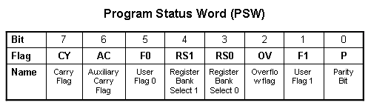
ADD Instructions
add a, byte ; a ← a + byte
addc a, byte ; a ← a + byte + C
These instructions affect 3 bits in PSW:
C = 1 if result of add is greater than FF
AC = 1 if there is a carry out of bit 3
OV = 1 if there is a carry out of bit 7, but not from bit 6, or visa versa.

Slide 58
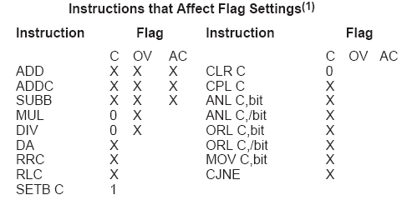
Instructions that Affect PSW bits

Slide 59
ADD Examples
mov a, #3Fh
add a, #D3h
What is the value of the C, AC, OV flags after the second instruction is executed?
0011 1111
1101 0011
0001 0010
C = 1
AC = 1
OV = 0

Slide 60
Signed Addition and Overflow
0111 1111 (positive 127)
0111 0011 (positive 115)
1111 0010 (overflow cannot represent 242 in 8 bits 2’s complement)
2’s complement:
0000 0000 00 0
…
0111 1111 7F 127
1000 0000 80 -128
…
1111 1111 FF -1
1000 1111 (negative 113)
1101 0011 (negative 45)
0110 0010 (overflow)
0011 1111 (positive)
1101 0011 (negative)
0001 0010 (never overflows)

Slide 61
Subtract
SUBB A, byte | subtract with borrow
Example:
SUBB A, #0x4F ;A ← A – 4F – C
Notice that
There is no subtraction WITHOUT borrow.
Therefore, if a subtraction without borrow is desired,
it is necessary to clear the C flag.
Example:
Clr c
SUBB A, #0x4F ;A ← A – 4F

Slide 62
Increment and Decrement
INC A | increment A
INC byte | increment byte in memory
INC DPTR | increment data pointer
DEC A | decrement accumulator
DEC byte | decrement byte
The increment and decrement instructions do NOT affect the C flag.
Notice we can only INCREMENT the data pointer, not decrement.

Slide 63
Example: Increment 16-bit Word
Assume 16-bit word in R3:R2
mov a, r2
add a, #1 ; use add rather than increment to affect C
mov r2, a
mov a, r3
addc a, #0 ; add C to most significant byte
mov r3, a

Slide 64
Multiply
When multiplying two 8-bit numbers, the size of the maximum product is 16-bits
FF x FF = FE01
(255 x 255 = 65025)
MUL AB ; BA ← A * B
Note : B gets the High byte
A gets the Low byte

Slide 65
Division
Integer Division
DIV AB ; divide A by B
A ← Quotient(A/B)
B ← Remainder(A/B)
OV - used to indicate a divide by zero condition.
C – set to zero

Slide 66
Decimal Adjust
DA a ; decimal adjust a
Used to facilitate BCD addition.
Adds “6” to either high or low nibble after an addition
to create a valid BCD number.
Example:
mov a, #23h
mov b, #29h
add a, b ; a ← 23h + 29h = 4Ch (wanted 52)
DA a ; a ← a + 6 = 52

Slide 67
Logic Instructions
Bitwise logic operations
  (AND, OR, XOR, NOT)
Clear
Rotate
Swap
Logic instructions do NOT affect the flags in PSW

Slide 68
Bitwise Logic
Examples:
ANL ➔ AND
ORL ➔ OR
XRL ➔ XOR
CPL ➔ Complement
00001111
10101100
ANL
00001100
00001111
10101100
ORL
10101111
00001111
10101100
XRL
10100011
CPL
10101100
01010011

Slide 69
Address Modes with Logic
ANL – AND
ORL – OR
XRL – eXclusive oR
CPL – Complement
a, byte
direct, reg. indirect, reg, immediate
byte, a
direct
byte, #constant
a ex: cpl a

Slide 70
Uses of Logic Instructions
Force individual bits low, without affecting other bits.
anl PSW, #0xE7 ;PSW AND 11100111
Force individual bits high.
orl PSW, #0x18 ;PSW OR 00011000
Complement individual bits
xrl P1, #0x40 ;P1 XRL 01000000

Slide 71
Other Logic Instructions
CLR - clear
RL – rotate left
RLC – rotate left through Carry
RR – rotate right
RRC – rotate right through Carry
SWAP – swap accumulator nibbles

Slide 72
CLR ( Set all bits to 0)
CLR A
CLR byte (direct mode)
CLR Ri (register mode)
CLR @Ri (register indirect mode)

Slide 73
Rotate
Rotate instructions operate only on a
RL a
Mov a,#0xF0 ; a← 11110000
RR a ; a← 11100001
RR a
Mov a,#0xF0 ; a← 11110000
RR a ; a← 01111000

Slide 74
Rotate through Carry
C
RRC a
mov a, #0A9h ; a ← A9
add a, #14h ; a ← BD (10111101), C←0
rrc a ; a ← 01011110, C←1
RLC a
mov a, #3ch ; a ← 3ch(00111100)
setb c ; c ← 1
rlc a ; a ← 01111001, C←1
C

Slide 75
Rotate and Multiplication/Division
Note that a shift left is the same as multiplying by 2, shift right is divide by 2
  mov a, #3 ; A← 00000011 (3)
  clr C ; C← 0
  rlc a ; A← 00000110 (6)
  rlc a ; A← 00001100 (12)
  rrc a ; A← 00000110 (6)

Slide 76
Swap
SWAP a
mov a, #72h ; a ← 27h
swap a ; a ← 27h

Slide 77
Bit Logic Operations
Some logic operations can be used with single bit operands
  ANL C, bit
  ORL C, bit
  CLR C
  CLR bit
  CPL C
  CPL bit
  SETB C
  SETB bit
“bit” can be any of the bit-addressable RAM locations or SFRs.

Slide 78
Shift/Mutliply Example
Program segment to multiply by 2 and add 1.

Slide 79
Program Flow Control
Unconditional jumps (“go to”)
Conditional jumps
Call and return

Slide 80
Unconditional Jumps
SJMP <rel addr> ; Short jump, relative address is 8-bit 2’s complement number, so jump can be up to 127 locations forward, or 128 locations back.
LJMP <address 16> ; Long jump
AJMP <address 11> ; Absolute jump to anywhere within 2K block of program memory
JMP @A + DPTR ; Long indexed jump

Slide 81
Infinite Loops
Start: mov C, p3.7
mov p1.6, C
sjmp Start
Microcontroller application programs are almost always infinite loops!

Slide 82
Conditional Jump
These instructions cause a jump to occur only if a condition is true. Otherwise, program execution continues with the next instruction.
  loop: mov a, P1
  jz loop ; if a=0, goto loop, ; else goto next instruction
  mov b, a
There is no zero flag (z)
Content of A checked for zero on time

Slide 83
Conditional jumps
Mnemonic | Description
JZ <rel addr> | Jump if a = 0
JNZ <rel addr> | Jump if a != 0
JC <rel addr> | Jump if C = 1
JNC <rel addr> | Jump if C != 1
JB <bit>, <rel addr> | Jump if bit = 1
JNB <bit>,<rel addr> | Jump if bit != 1
JBC <bir>, <rel addr> | Jump if bit =1, &clear bit
CJNE A, direct, <rel addr> | Compare A and memory, jump if not equal

Slide 84
Example: Conditional Jumps
if (a = 0) is true
  send a 0 to LED
else
send a 1 to LED
      jz led_off
      Setb P1.6
      sjmp skipover
led_off: clr P1.6
      mov A, P0
skipover:

Slide 85
More Conditional Jumps
Mnemonic | Description
CJNE A, #data <rel addr> | Compare A and data, jump if not equal
CJNE Rn, #data <rel addr> | Compare Rn and data, jump if not equal
CJNE @Rn, #data <rel addr> | Compare Rn and memory, jump if not equal
DJNZ Rn, <rel addr> | Decrement Rn and then jump if not zero
DJNZ direct, <rel addr> | Decrement memory and then jump if not zero

Slide 86
Call and Return
Call is similar to a jump, but
  Call pushes PC on stack before branching
acall <address ll> ; stack ← PC
; PC ← address 11 bit
lcall <address 16> ; stack ← PC
; PC ← address 16 bit

Slide 87
Return
Return is also similar to a jump, but
  Return instruction pops PC from stack to get address to jump to
    ret ; PC ← stack

Slide 88
Subroutines
call to the subroutine
Main: ...
acall sublabel
...
...
sublabel: ...
...
ret
the subroutine

Slide 89
Initializing Stack Pointer
SP is initialized to 07 after reset.(Same address as R7)
With each push operation 1st , pc is increased
When using subroutines, the stack will be used to store the PC, so it is very important to initialize the stack pointer. Location 2Fh is often used.
mov SP, #2Fh

Slide 90
Why Subroutines?
Subroutines allow us to have "structured" assembly language programs.
This is useful for breaking a large design into manageable parts.
It saves code space when subroutines can be called many times in the same program.

Slide 91
Interrupt Sources
Original 8051 has 5 sources of interrupts
  Timer 0 overflow
  Timer 1 overflow
  External Interrupt 0
  External Interrupt 1
  Serial Port events (buffer full, buffer empty, etc)
Enhanced version has 22 sources
  More timers, programmable counter array, ADC, more external interrupts, another serial port (UART)

Slide 92
Interrupt Process
If interrupt event occurs AND interrupt flag for that event is enabled, AND interrupts are enabled, then:
Current PC is pushed on stack.
Program execution continues at the interrupt vector address for that interrupt.
When a RETI instruction is encountered, the PC is popped from the stack and program execution resumes where it left off.

Slide 93
Interrupt Priorities
What if two interrupt sources interrupt at the same time?
The interrupt with the highest PRIORITY gets serviced first.
All interrupts have a default priority order.
Priority can also be set to “high” or “low”.

Slide 94
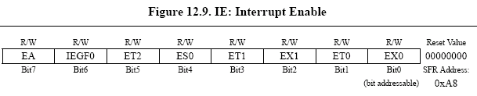
Interrupt SFRs
Interrupt enables for the 5 original 8051 interrupts:
Timer 2
Serial (UART0)
Timer 1
External 1
Timer 0
External 0
Global Interrupt Enable – must be set to 1 for any interrupt to be enabled
1 = Enable
0 = Disable

Slide 95
Interrupt Vectors
Each interrupt has a specific place in code memory where program execution (interrupt service routine) begins.
External Interrupt 0: 0003h
Timer 0 overflow: 000Bh
External Interrupt 1: 0013h
Timer 1 overflow: 001Bh
Serial : 0023h
Timer 2 overflow(8052+) 002bh
Note: that there are only 8 memory locations between vectors.

Slide 96
Interrupt Vectors
To avoid overlapping Interrupt Service routines, it is common to put JUMP instructions at the vector address. This is similar to the reset vector.
org 009B ; at EX7 vector
ljmp EX7ISR
cseg at 0x100 ; at Main program
Main: ... ; Main program
...
EX7ISR:... ; Interrupt service routine
... ; Can go after main program
reti ; and subroutines.

Slide 97
Three criteria in Choosing a Microcontroller
meeting the computing needs of the task efficiently and cost effectively
  speed, the amount of ROM and RAM, the number of I/O ports and timers, size, packaging, power consumption
  easy to upgrade
  cost per unit
availability of software development tools
  assemblers, debuggers, C compilers, emulator, simulator, technical support
wide availability and reliable sources of the microcontrollers

